Slide 1
Bandit –
A Wargame For Linux Beginners
Lab-1

Slide 2
LEVEL 0
Level Goal
The goal of this level is for you to log into the game using SSH. The host to which you need to connect is bandit.labs.overthewire.org, on port 2220. The username is bandit0 and the password is bandit0. Once logged in, go to the Level 1 page to find out how to beat Level 1.
Username : bandit0
Password : bandit0

Slide 3
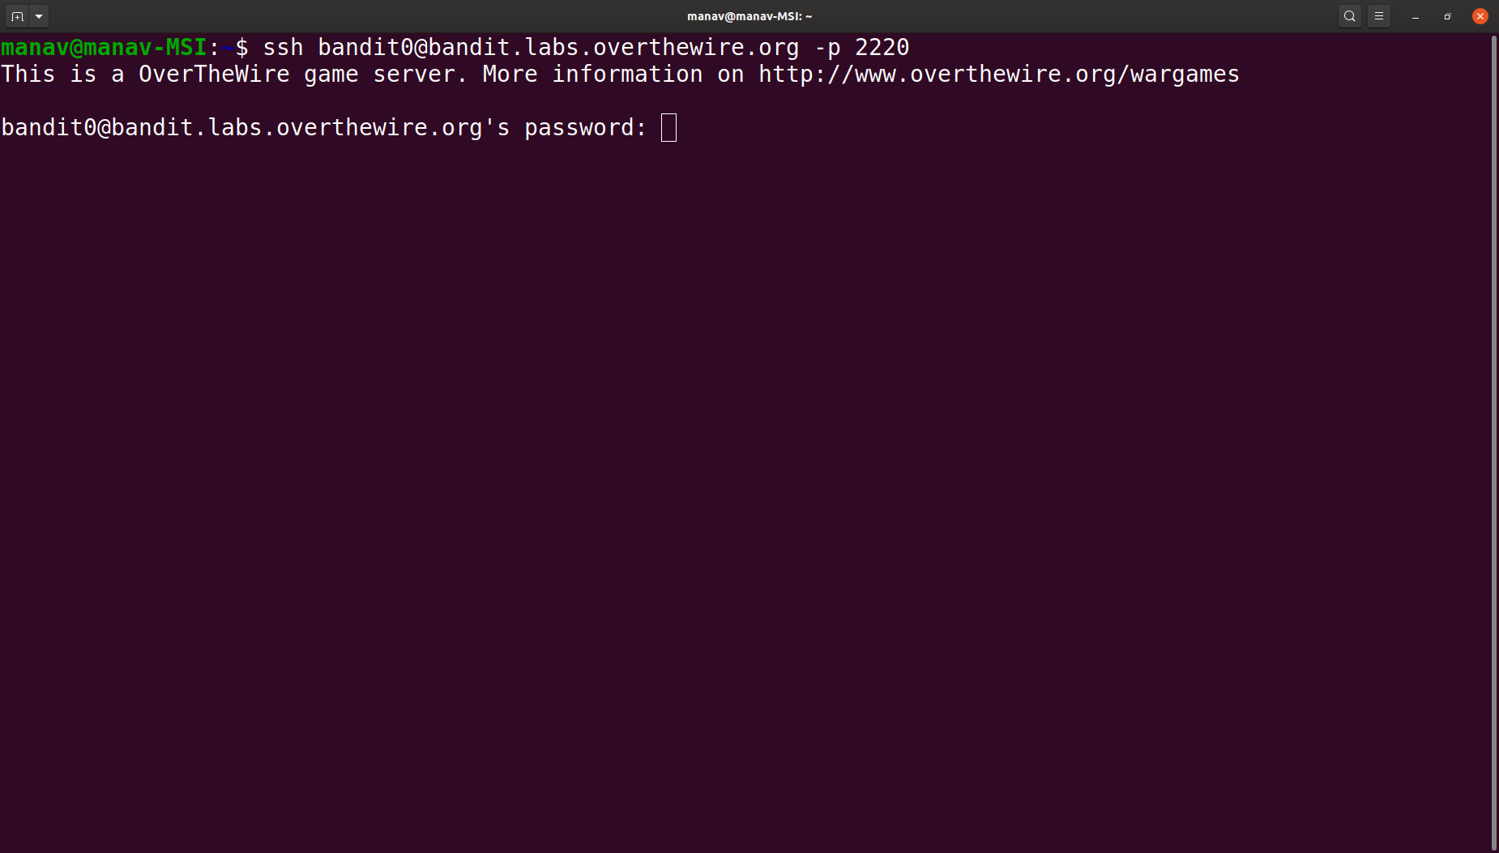
Bandit – A Wargame For Linux Beginners
How to Get Started With the Game?
1. Open Terminal and Enter the following command.
$ ssh bandit0@bandit.labs.overthewire.org -p 2220
It will ask for a password
Enter password -> bandit0

Slide 4
LEVEL 0 TO 1
Level Goal
The password for the next level is stored in a file called readme located in the home directory. Use this password to log into bandit1 using SSH. Whenever you find a password for a level, use SSH (on port 2220) to log into that level and continue the game.
Username: bandit1
Password : NH2SXQwcBdpmTEzi3bvBHMM9H66vVXjL

Slide 5
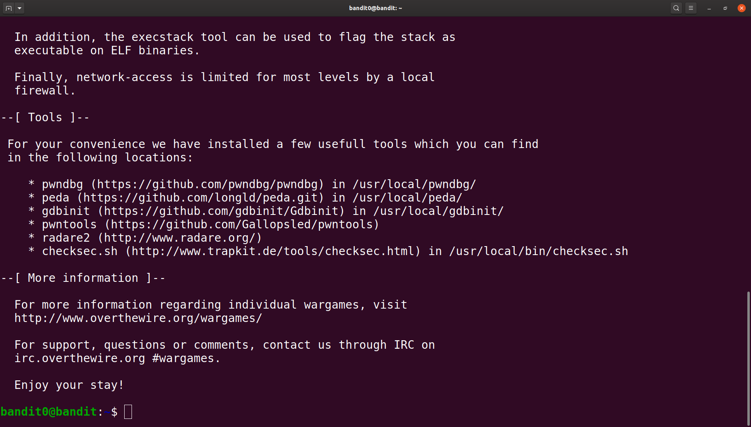
2. After entering the password you will be connected to the server of the game.
Now enter the following command
$ls
$cat readme
3. It will give you the password for the next level. The highlighted text in the image is the password for the next level.

Slide 6
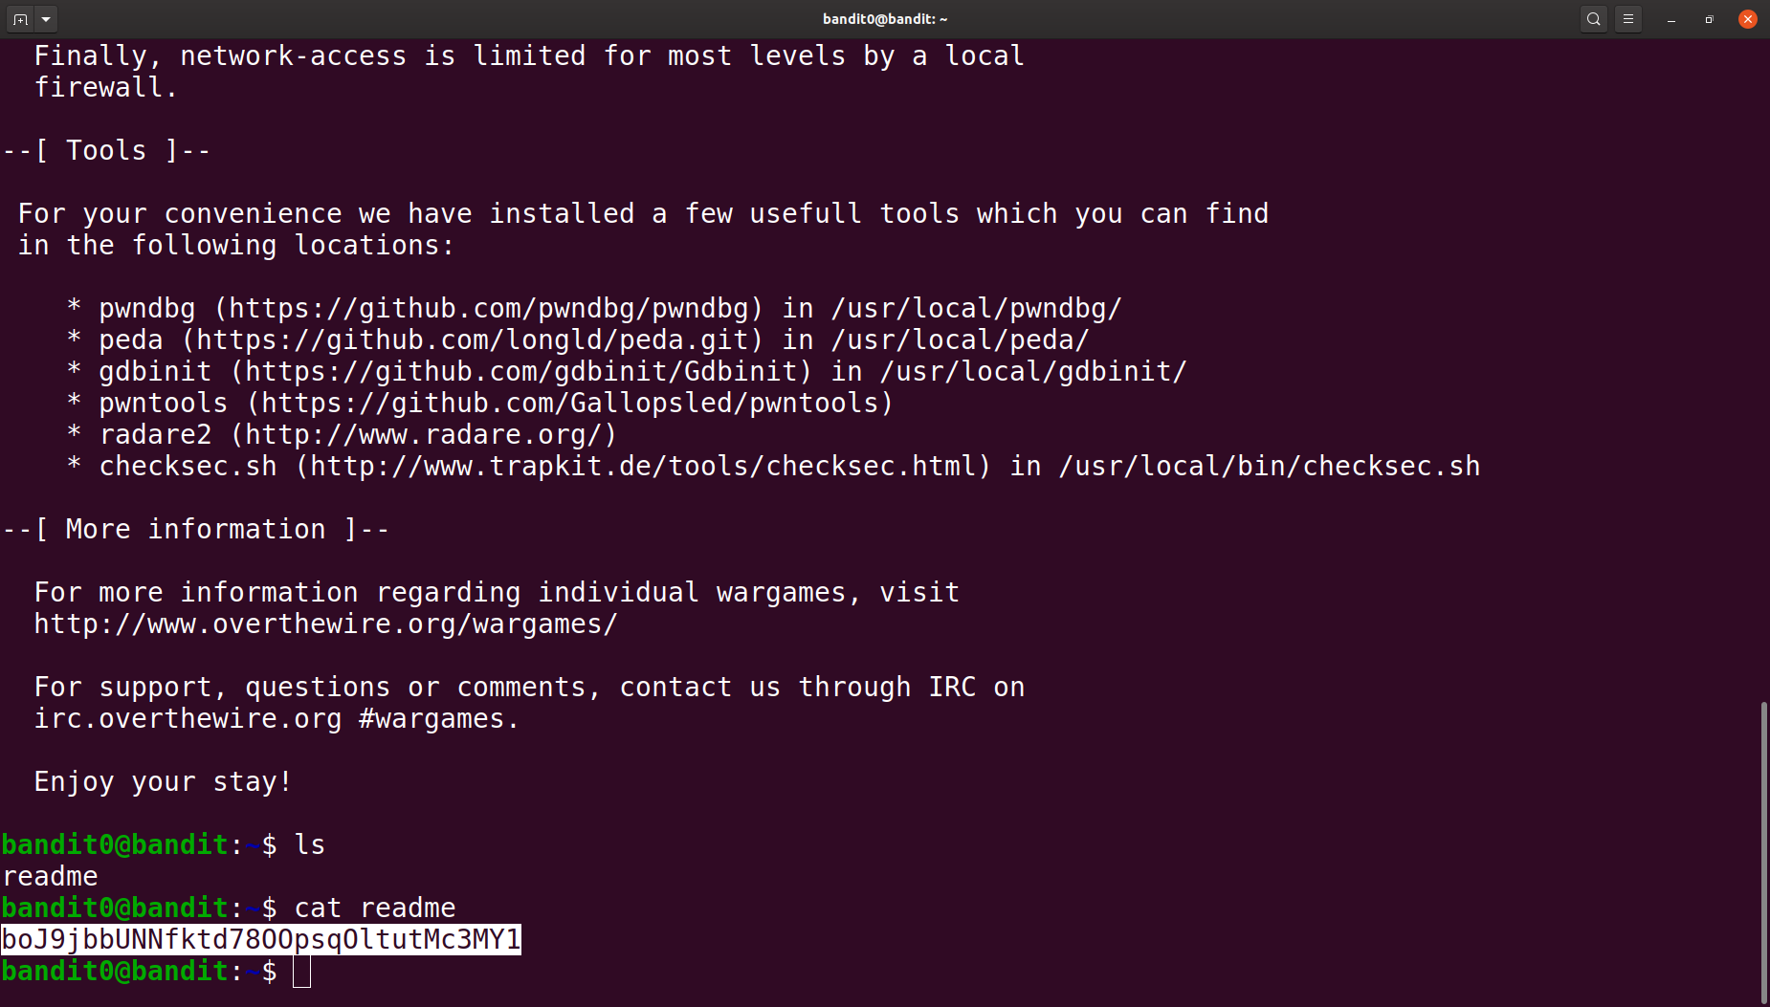
Now, after getting your first level done, use the exit command to exit the current level. Similarly, continue with the game, now to connect to level 1 use the following command.
$ ssh bandit1@bandit.labs.overthewire.org -p 2220
It will ask for the password. Enter the password we get from level 0

Slide 7
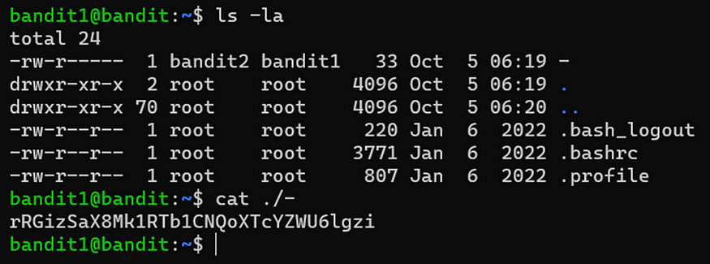
LEVEL 1 TO 2
Level Goal
The password for the next level is stored in a file called — located in the home directory
We can see there is a file name ‘-’ in the home directory, which I open using cat ./- , ./ represents the current directory.
Username: bandit2
Password: rRGizSaX8Mk1RTb1CNQoXTcYZWU6lgzi

Slide 8
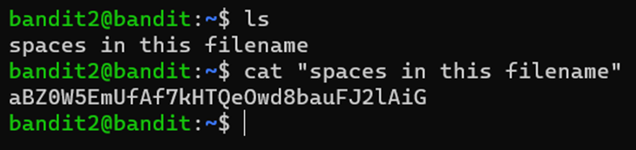
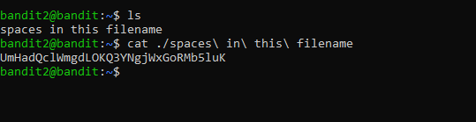
Bandit Level 2 → Level 3
Level Goal
The password for the next level is stored in a file called spaces in this filename located in the home directory.
for this i kept the filename in double quotes, because it helps to avoid issues caused by spaces being interpreted as argument separators.
Username: bandit3
Password: aBZ0W5EmUfAf7kHTQeOwd8bauFJ2lAiG

Slide 9
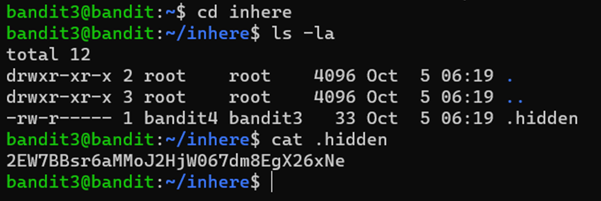
Bandit Level 3 → Level 4
Level Goal
The password for the next level is stored in a hidden file in the inhere directory.
first i used cd command to get in inhere directory, then used ls -la command as this command shows the hidden files and lastly use cat command to read what’s written in the file.
Username: bandit4
Password : 2EW7BBsr6aMMoJ2HjW067dm8EgX26xNe

Slide 10
Bandit Level 4 → Level 5
Level Goal
The password for the next level is stored in the only human-readable file in the inhere directory. Tip: if your terminal is messed up, try the “reset” command.
The command file ./-file0* is used to determine the file type of files in the current directory that match the pattern ‘-file0*’. And we can see that in the file07 the file is in ascii text, that’s why we cat the file and got the password.
Username: bandit5
Password : lrIWWI6bB37kxfiCQZqUdOIYfr6eEeqR

Slide 11
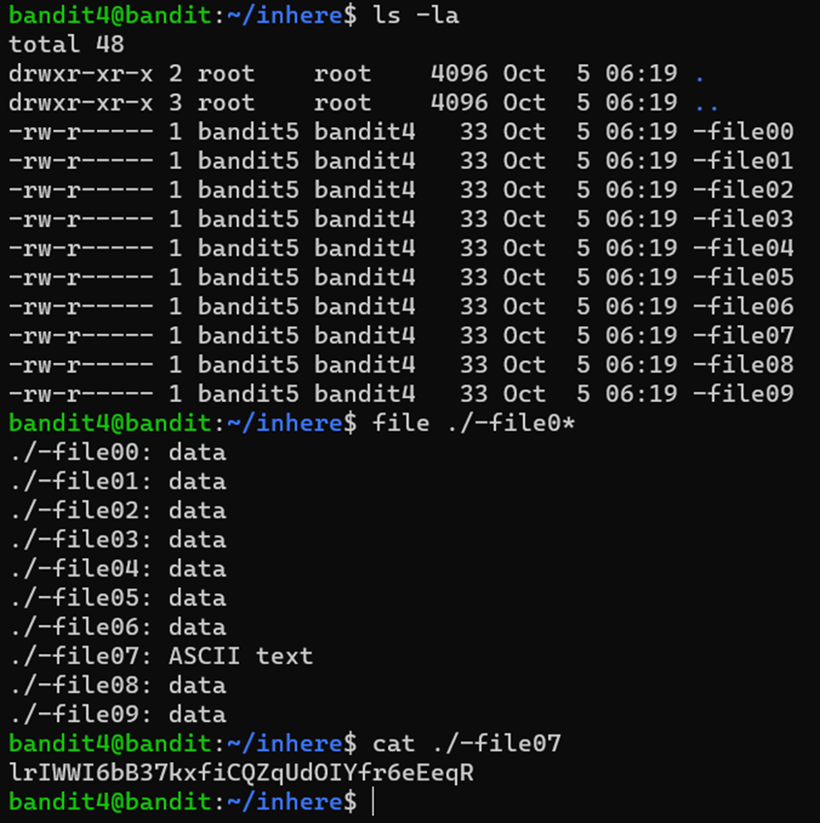

Slide 12
THANK YOU

